Slide 1

Geometry
Unit 13, Lesson 14 Using Coordinate Geometry to Solve Real-World Problems Volume 2, pg. 360

Slide 2


Benchmarks
MA.912.GR.3.2
Given a mathematical context, use coordinate geometry to classify or justify definitions, properties, and theorems involving circles, triangles, or quadrilaterals.
MA.912.GR.3.3
Use coordinate geometry to solve mathematical and real-world geometric problems involving lines, circles, triangles, and quadrilaterals.
MA.912.GR.3.4
Use coordinate geometry to solve mathematical and real-world problems on the coordinate plane involving perimeter or area of polygons.
volume 2, pg. 360

Slide 3
Integrated Mathematical Thinking and Reasoning Standards
MA.K12.MTR.1.1 Actively participate in effortful learning both individually and collectively.
MA.K12.MTR.2.1 Demonstrate understanding by representing problems in multiple ways.
MA.K12.MTR.3.1 Complete tasks with mathematical fluency.
MA.K12.MTR.4.1 Engage in discussions that reflect on the mathematical thinking of self and others.
MA.K12.MTR.5.1 Use patterns and structure to help understand and connect mathematical concepts.
MA.K12.MTR.6.1 Assess the reasonableness of solutions.
MA.K12.MTR.7.1 Apply mathematics to real-world contexts.
volume 2, pg. 360

Slide 4

Learning Targets
I can use coordinate geometry to classify triangles and quadrilaterals.
I can use coordinate geometry to solve real-world problems on the coordinate plane involving perimeter or area of polygons.
I can use coordinate geometry to solve real-world geometric problems involving circles, triangles, and quadrilaterals.
volume 2, pg. 360

Slide 5

Warm-Up
volume 2, pg. 360

Slide 6
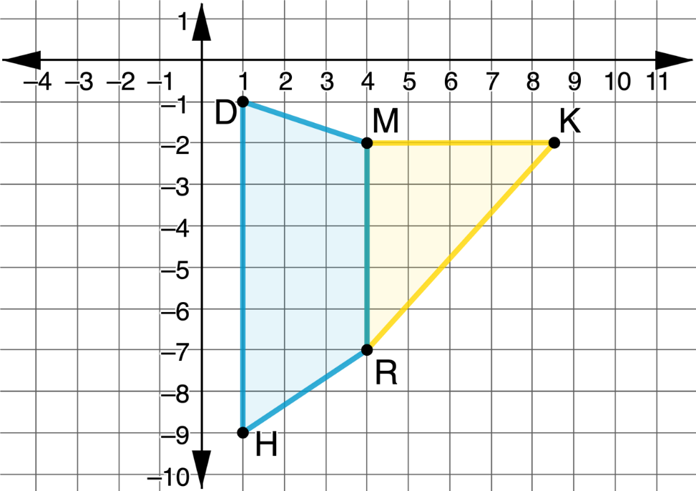
13.14.1 Warm-Up: Bell Work
The composite figure shown is created by $∆MKR$ and trapezoid 𝐷𝑀𝑅𝐻. $M(4,−2)$, $K(8.5,−2)$, $R(4,−7)$, $H(1,−9)$, and $D(1,−1)$.
volume 2, pg. 360

Slide 7

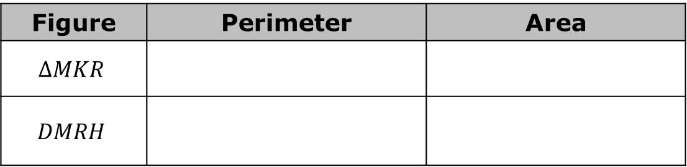
Complete the table. If necessary, round to the nearest thousandth.
Figure | Perimeter | Area
$$∆MKR$$
$$DMRH$$
What is the perimeter of the composite figure? If necessary, round to the nearest thousandth.
What is the area of the composite figure? If necessary, round to the nearest thousandth.
volume 2, pg. 360

Slide 8

Collaboration
volume 2, pg. 361

Slide 9

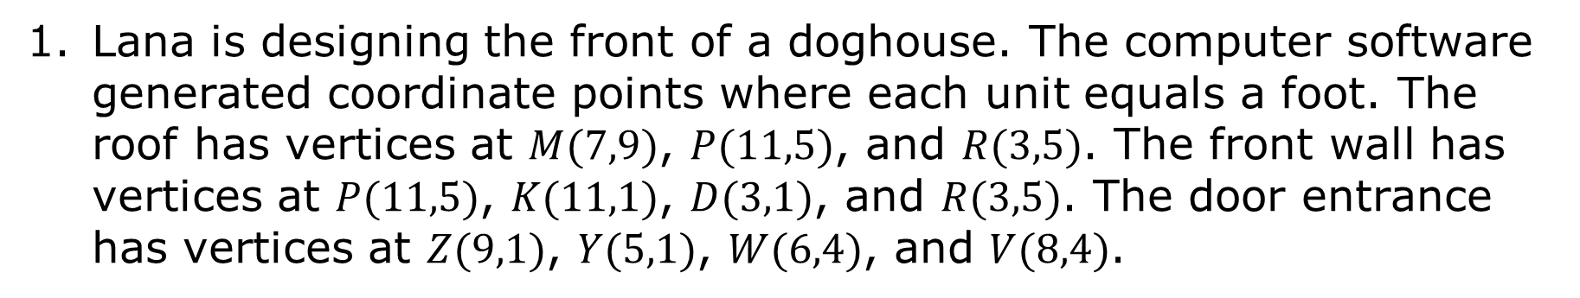
13.14.2 Collaboration: Real-World Problems
Lana is designing the front of a doghouse. The computer software generated coordinate points where each unit equals a foot. The roof has vertices at $M(7,9)$, $P(11,5)$, and $R(3,5)$. The front wall has vertices at $P(11,5)$, $K(11,1)$, $D(3,1)$, and $R(3,5)$. The door entrance has vertices at $Z(9,1)$, $Y(5,1)$, $W(6,4)$, and $V(8,4)$.
volume 2, pg. 361

Slide 10
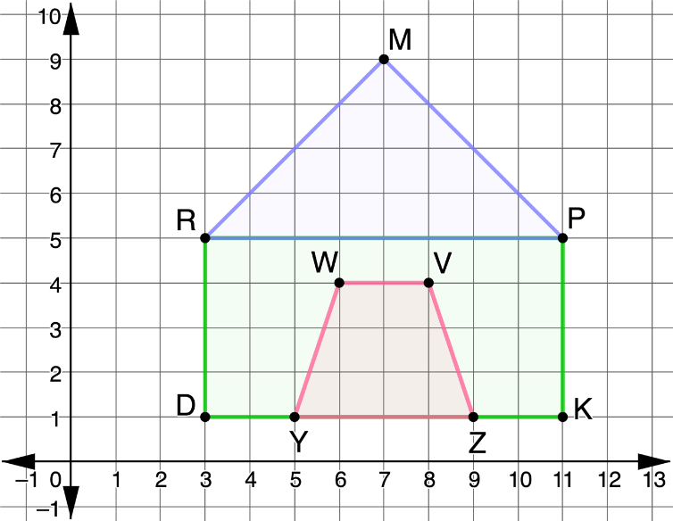
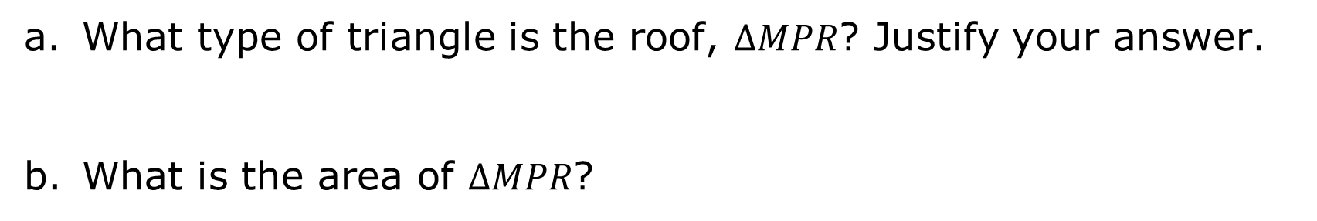
What type of triangle is the roof, $∆MPR$? Justify your answer.
What is the area of $∆MPR$?
volume 2, pg. 361

Slide 11
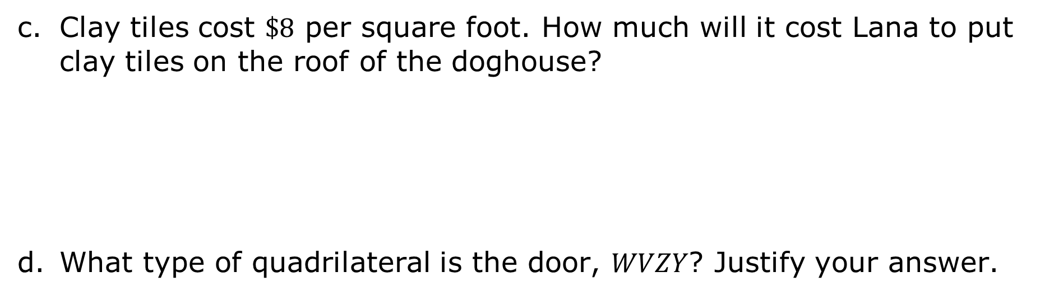
Clay tiles cost $\$8$ per square foot. How much will it cost Lana to put clay tiles on the roof of the doghouse?
What type of quadrilateral is the door, 𝑊𝑉𝑍𝑌? Justify your answer.
volume 2, pg. 361

Slide 12
Lana is placing a frame around the door, 𝑊𝑉𝑍𝑌. How many feet of wood will she need? If necessary, round to the nearest thousandth.
What type of quadrilateral is the front wall, 𝑅𝑃𝐾𝐷? Justify your answer.
volume 2, pg. 361

Slide 13
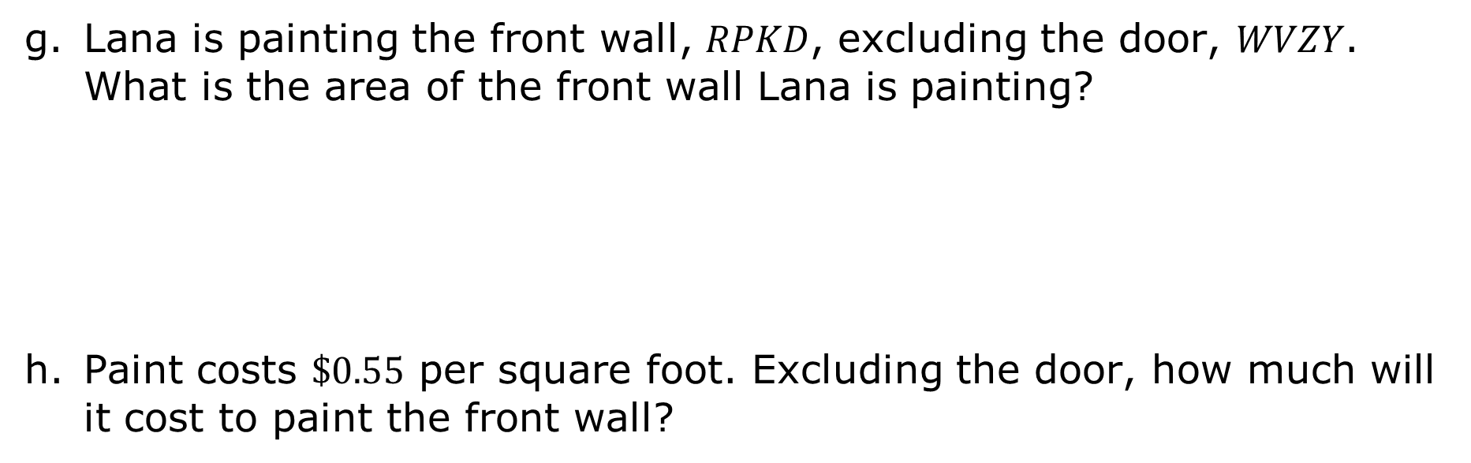
Lana is painting the front wall, 𝑅𝑃𝐾𝐷, excluding the door, 𝑊𝑉𝑍𝑌. What is the area of the front wall Lana is painting?
Paint costs $\$0.55$ per square foot. Excluding the door, how much will it cost to paint the front wall?
volume 2, pg. 362

Slide 14
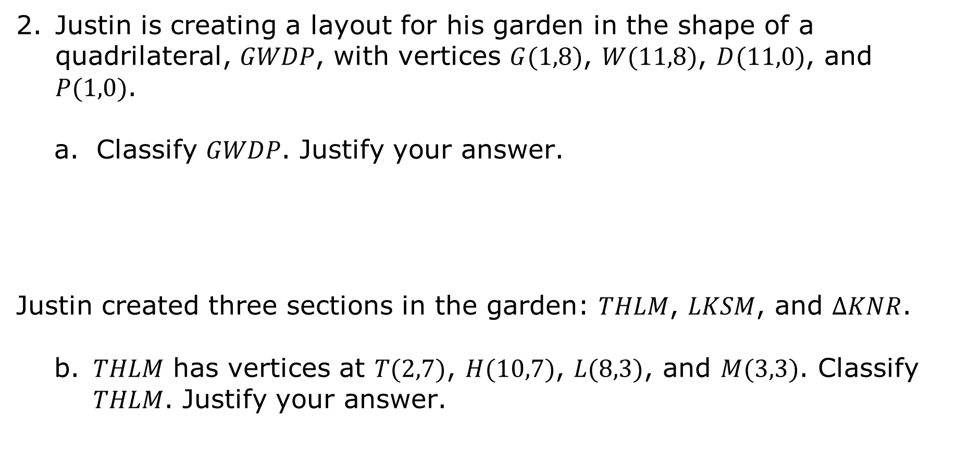
Justin is creating a layout for his garden in the shape of a quadrilateral, 𝐺𝑊𝐷𝑃, with vertices $G(1,8)$, $W(11,8)$, $D(11,0)$, and $P(1,0)$.
Classify 𝐺𝑊𝐷𝑃. Justify your answer.
Justin created three sections in the garden: 𝑇𝐻𝐿𝑀, 𝐿𝐾𝑆𝑀, and $∆KNR$.
𝑇𝐻𝐿𝑀 has vertices at $T(2,7)$, $H(10,7)$, $L(8,3)$, and $M(3,3)$. Classify 𝑇𝐻𝐿𝑀. Justify your answer.
volume 2, pg. 362

Slide 15

𝐿𝐾𝑆𝑀 has vertices at $L(8,3)$, $K(7,1)$, $S(2,1)$, and $M(3,3)$. Classify 𝐿𝐾𝑆𝑀. Justify your answer.
$∆KNR$ has vertices at $K(7,1)$, $N(9,1)$, and $R(9,5)$. Classify $∆KNR$. Justify your answer.
volume 2, pg. 362

Slide 16
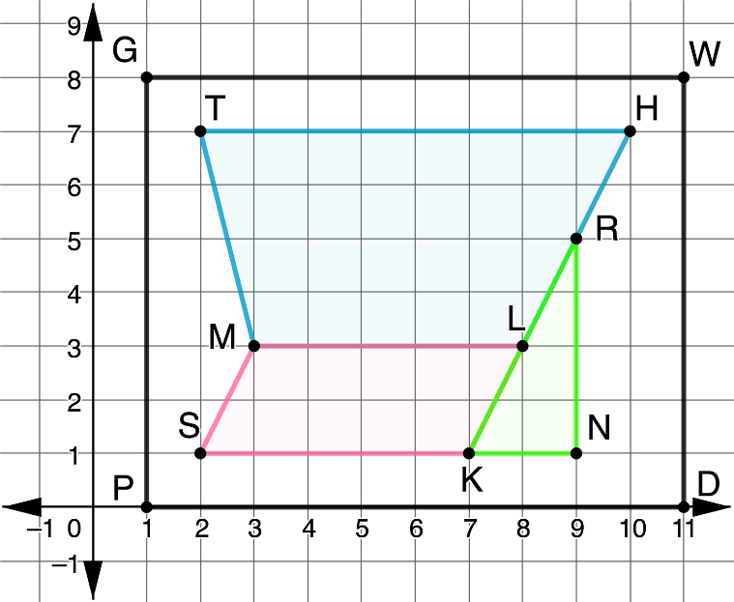
The layout of the garden is shown.
If one square on the grid represents one square foot, how many feet of fencing will Justin need to go around 𝐺𝑊𝐷𝑃?
volume 2, pg. 363

Slide 17
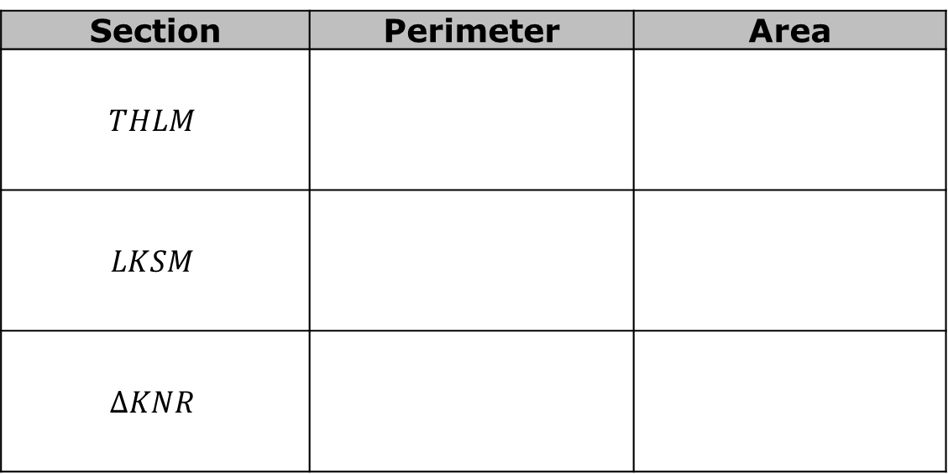
Complete the table. If necessary, round to the nearest thousandth.
Section | Perimeter | Area
$$THLM$$
$$LKSM$$
$$∆KNR$$
What is the perimeter of the composite figure made by the three sections of the garden? If necessary, round to the nearest thousandth.
volume 2, pg. 363

Slide 18
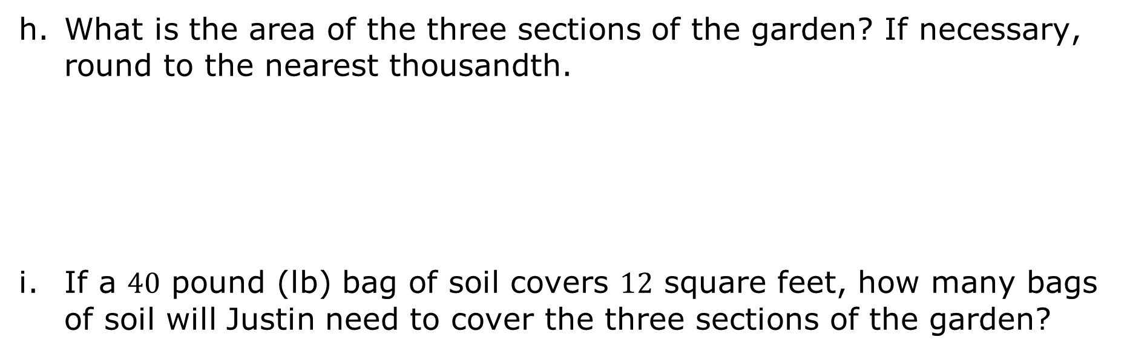
What is the area of the three sections of the garden? If necessary, round to the nearest thousandth.
If a $40$ pound (lb) bag of soil covers $12$ square feet, how many bags of soil will Justin need to cover the three sections of the garden?
volume 2, pg. 363

Slide 19
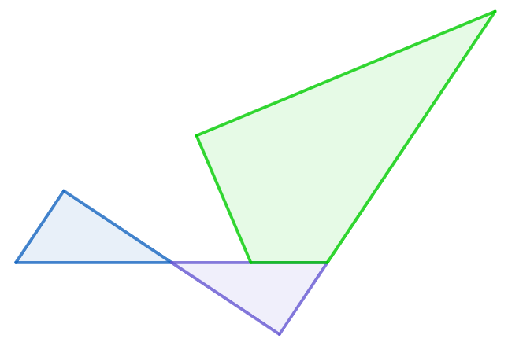
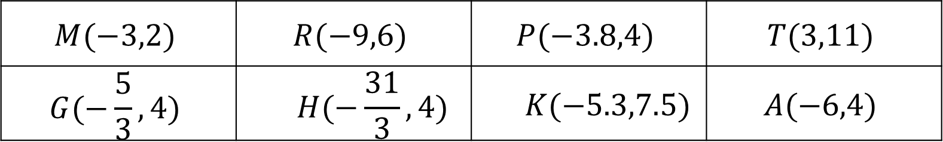
Edwin started creating a new logo design for the company office using the images shown.
­To determine how to place the logo on the wall in the company’s office, he uploaded his design to a computer program and got the following coordinates.
$$M(−3,2)$$ | $$R(−9,6)$$ | $$P(−3.8,4)$$ | $$T(3,11)$$
$$G(−\frac{5}{3},4)$$ | $$H(−\frac{31}{3},4)$$ | $$K(−5.3,7.5)$$ | $$A(−6,4)$$
volume 2, pg. 364

Slide 20
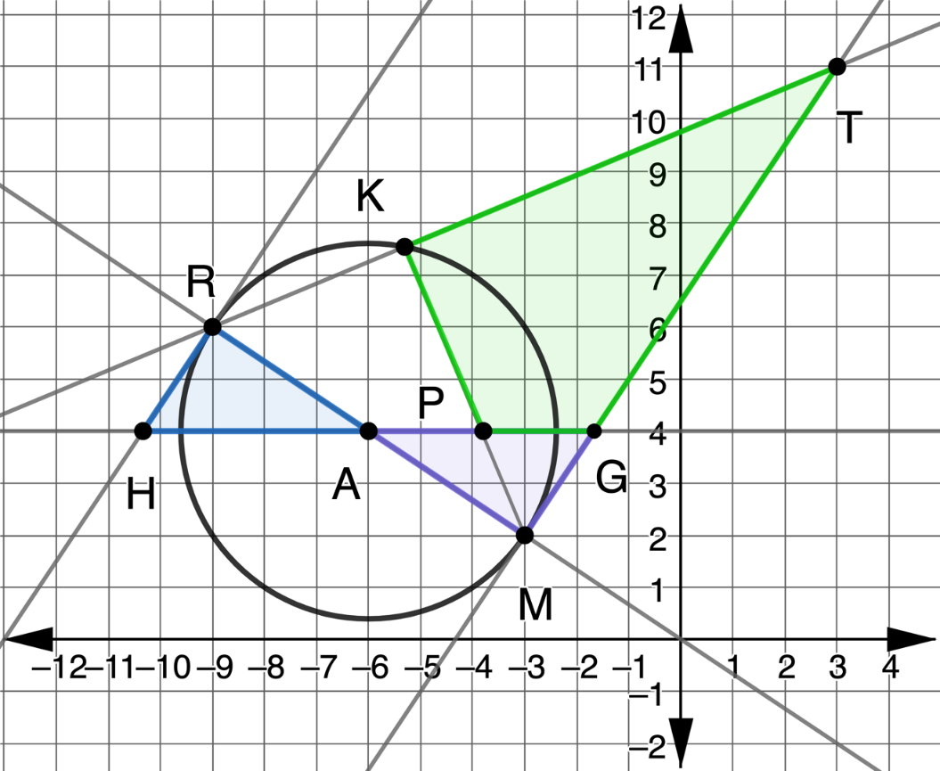
Circle 𝐴 has points 𝑅, 𝑀, and 𝐾 on the circle. Lines 𝑇𝑀 and 𝐻𝑅 are tangent to circle 𝐴. Lines 𝑅𝑀 and 𝐻𝐺 are secant to circle 𝐴.
volume 2, pg. 364

Slide 21
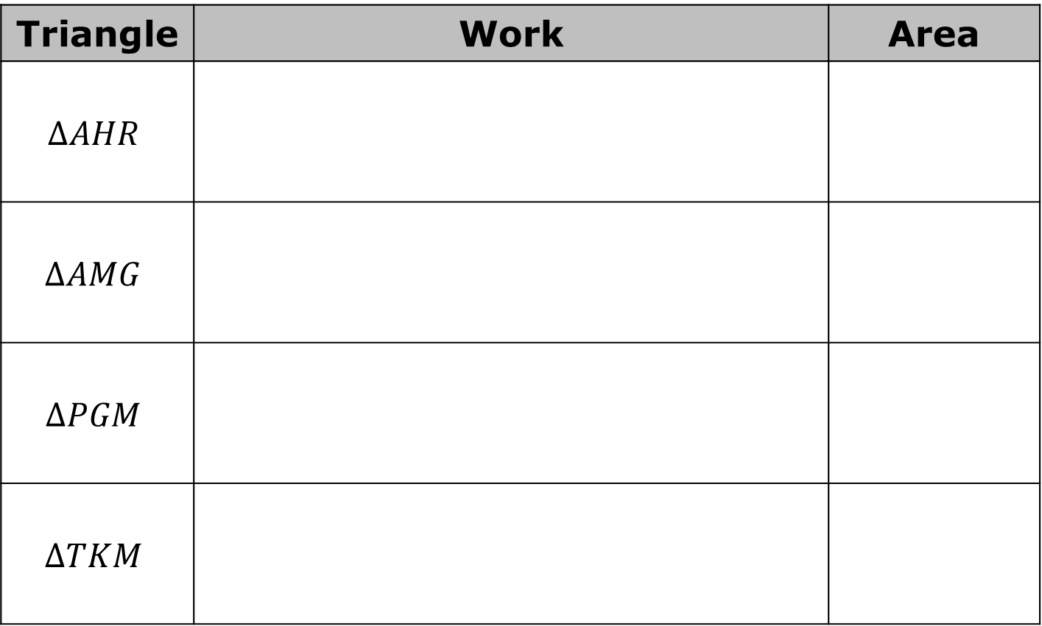
Complete the table by finding the area of each triangle.
Triangle | Work | Area
$$∆AHR$$
$$∆AMG$$
$$∆PGM$$
$$∆TKM$$
volume 2, pg. 364

Slide 22
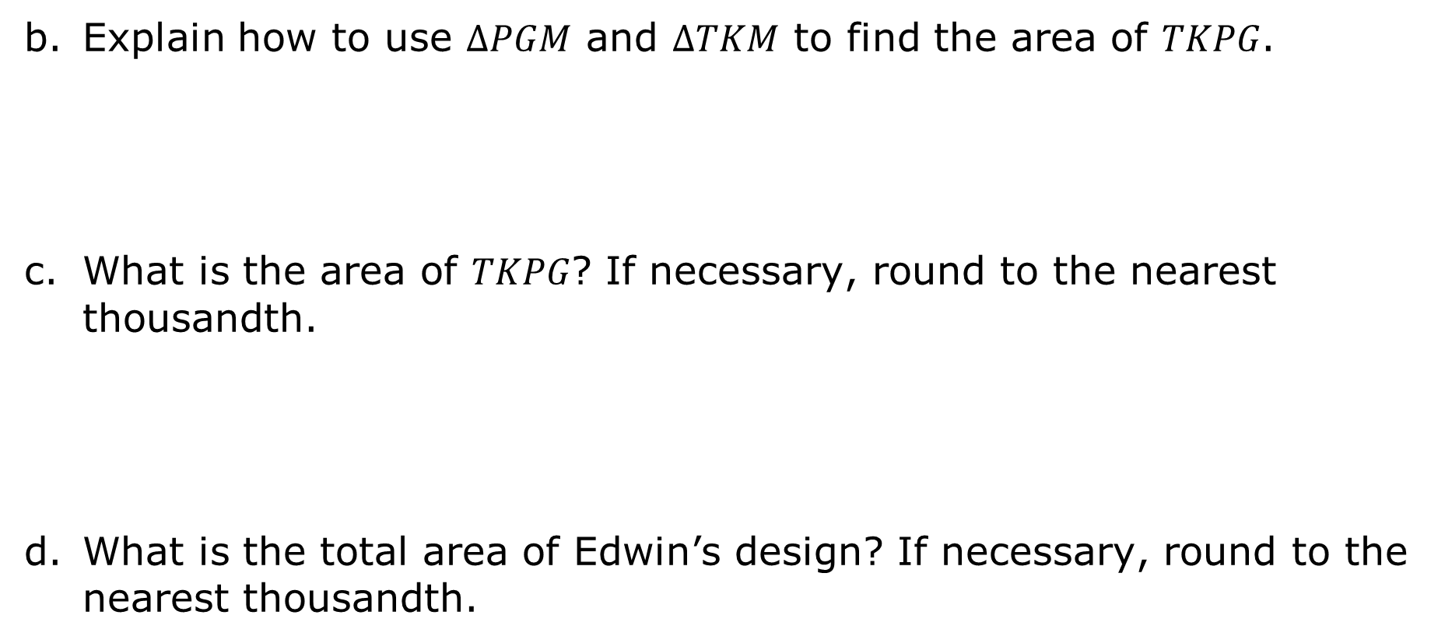
Explain how to use $∆PGM$ and $∆TKM$ to find the area of 𝑇𝐾𝑃𝐺.
What is the area of 𝑇𝐾𝑃𝐺? If necessary, round to the nearest thousandth.
What is the total area of Edwin’s design? If necessary, round to the nearest thousandth.
volume 2, pg. 364

Slide 23

Wrap-Up
volume 2, pg. 365

Slide 24




13.14.3 Wrap-Up: Reflection
Circle the icon that best describes your understanding of each.
I need help. I got it. I could help someone
Using coordinate geometry to determine if lines are parallel or perpendicular.
Using coordinate geometry to partition a line segment or find the weighted average.
Using coordinate geometry to classify triangles or quadrilaterals.
Using coordinate geometry to justify definitions, properties, and theorems involving circles, triangles or quadrilaterals.
Using coordinate geometry to solve mathematical and real-world geometric problems involving lines, circles, triangles, and quadrilaterals.
Using coordinate geometry to solve mathematical and real-world involving perimeter or area of polygons.
volume 2, pg. 365

